Slide 1
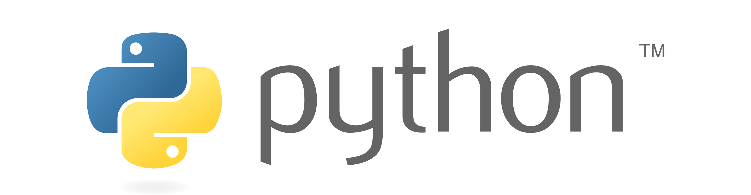

Slide 2
Encapsulation
Encapsulation is one of the fundamental concepts in object-oriented programming (OOP), including abstraction, inheritance, and polymorphism.
Encapsulation in Python describes the concept of bundling data and methods within a single unit.
So, for example, when you create a class, it means you are implementing encapsulation. A class is an example of encapsulation as it binds all the data members (instance variables) and methods into a single unit.

Slide 3
Using encapsulation, we can hide an object’s internal representation from the outside. This is called information hiding.
Also, encapsulation allows us to restrict accessing variables and methods directly and prevent accidental data modification by creating private data members and methods within a class.
Encapsulation is a way to can restrict access to methods and variables from outside of class. Whenever we are working with the class and dealing with sensitive data, providing access to all variables used within the class is not a good choice.
Encapsulation can be achieved by declaring the data members and methods of a class either as private or protected. But In Python, we don’t have direct access modifiers like public, private, and protected. We can achieve this by using single underscore and double underscores.

Slide 4
Public Members
Public data members are accessible within and outside of a class. All member variables of the class are by default public.
class Student:
def __init__(self,name,roll):
self.name=name
self.roll=roll
def show(self):
print(self.name)
print(self.roll)
s=Student(‘ankush’,121)
s.show()
Output :
ankush
121

Slide 5
Private Members
We can protect variables in the class by marking them private. To define a private variable add two underscores as a prefix at the start of a variable name.
Private members are accessible only within the class, and we can’t access them directly from the class objects.
class Student:
def __init__(self,name,roll):
self.name=name
self.__roll=roll
def show(self):
print(self.name)
s=Student(‘ankush’,121)
s.show()
print(s.name, s.__roll)
Output :
ankush
AttributeError: 'Student' object has no attribute '__roll'

Slide 6
We can access private members from outside of a class using the following two approaches
Create public method to access private members
Use name mangling

Slide 7
Public method to access private members
Access Private member outside of a class using an instance method
class Student:
def __init__(self,name,roll):
self.name=name
self.__roll=roll
def show(self):
print(self.name)
print(self.__roll)
s=Student(‘ankush’,121)
s.show()
Output :
ankush
121

Slide 8
Name Mangling to access private members
We can directly access private and protected variables from outside of a class through name mangling. The name mangling is created on an identifier by adding two leading underscores and one trailing underscore, like this _classname__dataMember, where classname is the current class, and data member is the private variable name.
Output :
ankush
121
class Student:
def __init__(self,name,roll):
self.name=name
self.__roll=roll
s=Student(ankush,121)
print(s.name)
print(s._Student__roll)

Slide 9
Getters and Setters in Python
To implement proper encapsulation in Python, we need to use setters and getters. The primary purpose of using getters and setters in object-oriented programs is to ensure data encapsulation. Use the getter method to access data members and the setter methods to modify the data members.
In Python, private variables are not hidden fields like in other programming languages. The getters and setters methods are often used when
When we want to avoid direct access to private variables
To add validation logic for setting a value

Slide 10
Example
class Student:
def __init__(self, name, age):
# private member
self.name = name
self.__age = age
# getter method
def get_age(self):
return self.__age
# setter method
def set_age(self, age):
self.__age = age
stud = Student('ankush', 121)
# retrieving age using getter
print('Name:', stud.name, stud.get_age())
# changing age using setter
stud.set_age(21)
# retrieving age using getter
print('Name:', stud.name, stud.get_age())

Slide 11
Advantages of Encapsulation
Security: The main advantage of using encapsulation is the security of the data. Encapsulation protects an object from unauthorized access. It allows private and protected access levels to prevent accidental data modification.
Data Hiding: The user would not be knowing what is going on behind the scene. They would only be knowing that to modify a data member, call the setter method. To read a data member, call the getter method. What these setter and getter methods are doing is hidden from them.
Simplicity: It simplifies the maintenance of the application by keeping classes separated and preventing them from tightly coupling with each other.
Aesthetics: Bundling data and methods within a class makes code more readable and maintainable

